Slide 1
The BLITZ Technology Department
Everything You Always Wanted to Know,
But Were Afraid to Ask about
Proprietary and Confidential - © Blitz Digital Studios, LLC.
1

Slide 2
Technology Deployment Platforms
Desktop and Kiosk
Mobile Devices
Internet
Game Consoles
Target Audience
Proprietary and Confidential - © Blitz Digital Studios, LLC.
2

Slide 3
Technology Service Offerings
Interactive Branded Experiences
Web (2.0) Development
On-Line / Interactive Video
Social Networks and Community Sites
Rich Internet Applications & Mash-Ups
Kiosks
Product Configurators
Widget & Gadget Platforms
On-Line (site / blog embeds)
Desktop / Sidebar / System Tray
Analytics Integration and Reporting
Games & Gaming Platforms
On-Line, Downloadable, Single & Multi-Player
Player Accounts & Leader Boards
Marketing Campaign Platforms
Email Marketing
Viral Marketing – Send to / Challenge a friend
Contests, Polls, Sweepstakes, Surveys
E-Commerce
Wireless & Mobile Development
Handset Software Development
Handset Internet Accessible Content (Sites)
Content & Asset Management,
Content & User Interface Personalization
IT Services & Consulting (Digital Launch Pad)
Proprietary and Confidential - © Blitz Digital Studios, LLC.
3

Slide 4
User Interface Development
D/H/X/HTML
HTML5
CSS
JavaScript
Mobile Platforms
XHTML
iPhone Native Development (Objective-C)
Windows Phone 7
WebKit Browser (Android and iPhone Specific)
Adobe AIR (Android, RIM 6)
Adobe Platforms
Flash Player (Web)
FLEX
Adobe Integrated Runtime (AIR) (Desktop)
Papervision3D
Away3D
"Molehill" Native 3D
Microsoft Platforms
Silverlight
WPF
XNA
Proprietary and Confidential - © Blitz Digital Studios, LLC.
4

Slide 5
Server-side Development
LAMP Stack
PHP5
MySQL
Microsoft Stack
ASP.NET
MSSQL
Adobe Platforms
Flash Media Server
Flash Remoting & AMFPHP
Content Management
SilverStripe
Drupal
Umbraco
Sitecore
Ektron
Sharepoint
Proprietary and Confidential - © Blitz Digital Studios, LLC.
5

Slide 6
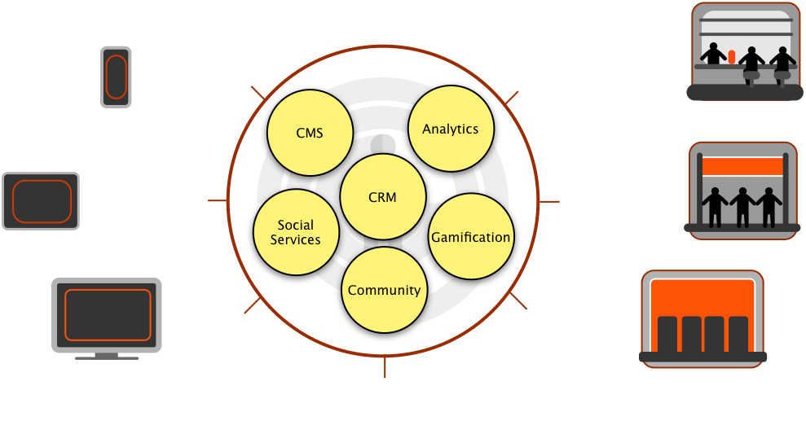
Brand as Application

Slide 7
BLITZ GLUE
Website
Mobile
App
TV App
BLITZ UI
Web Head
Mobile
Head
TV
Head
BLITZ GLUE
CMS
Persona
Community
Gamification
Analytics
Social

